Slide 1
DAT 500S Module 8
Textbook Quiz:
Exercise 8.4: Problems 2,5
Group Assignment:
Exercise 8.4: Problem 12
Individual Assignment:
Exercise 8.4: Problem 8 (d),(e) & 10

Slide 2
Bagging
Generate B different bootstrapped training datasets
Train the statistical learning method on each of the B training datasets, and obtain the prediction
For prediction:
Regression: average all predictions from all B trees
Classification: majority vote among all B trees

Slide 3
Random Forests
It is a very efficient machine learning method
It builds on the idea of bagging, but it provides an improvement because it de-correlates the trees
How does it work?
Build a number of decision trees on bootstrapped training sample, but when building these trees, each time a split in a tree is considered, a random sample of m predictors is chosen as split candidates from the full set of p predictors (Usually )

Slide 4
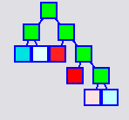
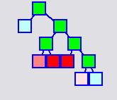
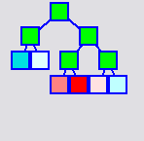
Boosted Trees
Tree 1
Tree 2
Tree 3
+
+
First tree grown on original target. Intentionally “weak” model
2nd tree grown on residuals from first. Predictions made to improve first tree
3rd tree grown on residuals from model consisting of first two trees

Slide 5
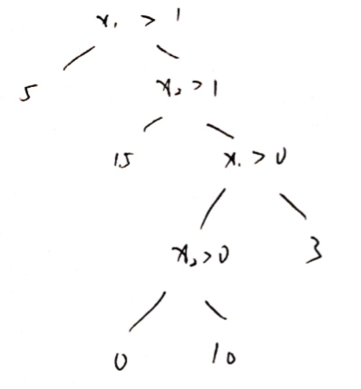
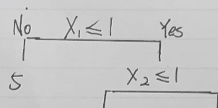
Incorrect Tree Representation

Slide 6
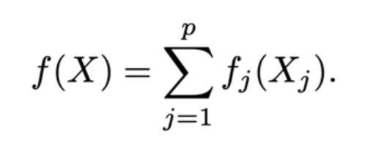
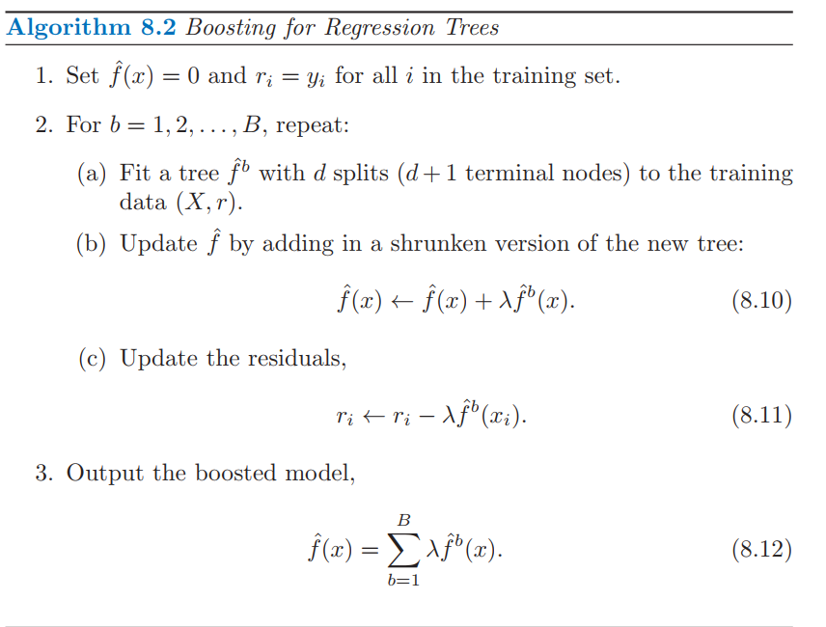
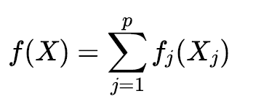

Exercise 8.4: Problems 2
boosting using depth-one trees (or stumps) leads to an additive model: that is, a model of the form
First iteration: f(x)=λ${\hat{f}}^{1}(x)$
r_{i}=y_{i} - λ${\hat{f}}^{1}(x)$
Second iteration: f(x)=λ${\hat{f}}^{1}(x)$ + λ${\hat{f}}^{2}(x)$
r_{i}=y_{i} - λ${\hat{f}}^{1}\left(x\right)−\text{λ}{\hat{f}}^{2}\left(x\right)$
Uses another predictor to maximize the fit to residuals.
Therefore,
Notes:
Draw a decision tree corresponding to this partition.

Slide 7
Exercise 8.4: Problem 5
Problem #5: Suppose we produce ten bootstrapped samples from a data set containing red and green classes. We then apply a classification tree to each bootstrapped sample and, for a specific value of X, produce 10 estimates of P(Class is Red|X): 0.1, 0.15, 0.2, 0.2, 0.55, 0.6, 0.6, 0.65, 0.7, and 0.75
There are two common ways to combine these results together into a single class prediction. One is the majority vote approach discussed in this chapter. The second approach is to classify based on the average probability.

Slide 8
Exercise 8.4: Problem 5
what is the final classification under each of these two approaches?
The majority vote approach:
0.1(Green), 0.15(Green), 0.2(Green), 0.2(Green), 0.55(Red), 0.6 (Red), 0.6 (Red), 0.65 (Red), 0.7 (Red), and 0.75 (Red)
Majority is red so X will be classified as Red
Based on average probably:
Average probability = (0.1+0.15+0.2+0.55+0.6+0.6+0.65+0.7+0.75)/10 = 0.45
X will be classified as Green

Slide 9
Group Assignment Exercise 8.4 Q12
Apply boosting, bagging, and random forests to a data set of your choice. Be sure to fit models on a training set and to evaluate their performance on a test set. How accurate are the results compared to simple methods like linear or logistic regression ? Which of these approaches yields the best performance ?
For demonstration, we will use the “Weekly” data set from the “ISLR” package to predict the “Direction” variable.
Splitting into training and test data
set.seed(1)
train <- sample(nrow(Weekly), nrow(Weekly) / 2)
Weekly$Direction <- ifelse(Weekly$Direction == "Up", 1, 0)
Weekly.train <- Weekly[train, ]
Weekly.test <- Weekly[-train, ]

Slide 10
Group Assignment Exercise 8.4 Q12
Bagging
bag.fit <- randomForest(Direction ~ . - Year - Today, data = Weekly.train, mtry = 6)
bag.probs <- predict(bag.fit, newdata = Weekly.test)
bag.pred <- ifelse(bag.probs > 0.5, 1, 0)
table(Weekly.test$Direction, bag.pred)
Notes:
Recall that bagging is simply a special case of a random forest with m = p.

Slide 11
Group Assignment Exercise 8.4 Q12
Random forest
rf.fit <- randomForest(Direction ~ . - Year - Today, data = Weekly.train, mtry = 2)
rf.probs <- predict(rf.fit, newdata = Weekly.test)
rf.pred <- ifelse(rf.probs > 0.5, 1, 0)
table(Weekly.test$Direction, rf.pred)
Notes:
Recall that bagging is simply a special case of a random forest with m = p.
. By default, randomForest() uses p/3 variables when building a random forest of regression trees, and √p variables when building a random forest of classification trees

Slide 12
Group Assignment Exercise 8.4 Q12
Boosting
boost.fit <- gbm(Direction ~ . - Year - Today, data = Weekly.train, distribution = "bernoulli", n.trees = 5000)
boost.probs <- predict(boost.fit, newdata = Weekly.test, n.trees = 5000)
boost.pred <- ifelse(boost.probs > 0.5, 1, 0)
table(Weekly.test$Direction, boost.pred)

Slide 13
Group Assignment Exercise 8.4 Q12
Logistics Regression
logit.fit <- glm(Direction ~ . - Year - Today, data = Weekly.train, family = "binomial")
logit.probs <- predict(logit.fit, newdata = Weekly.test, type = "response")
logit.pred <- ifelse(logit.probs > 0.5, 1, 0)
table(Weekly.test$Direction, logit.pred)
- Compare classification error rates over different methods

